Slide 1
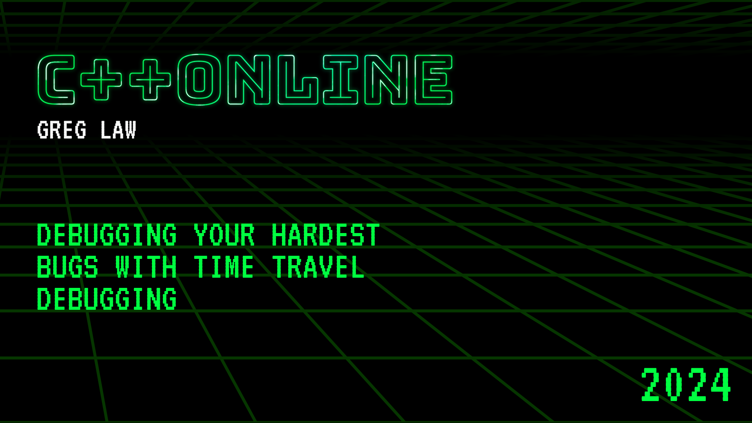
Time Travel Debugging
Greg Law

Slide 2
Most programmers spend most of their time debugging.

Slide 3


Slide 4
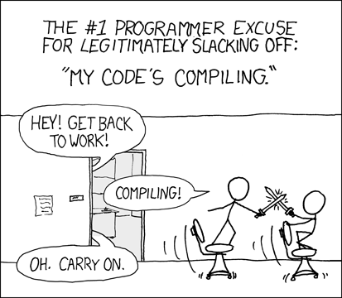
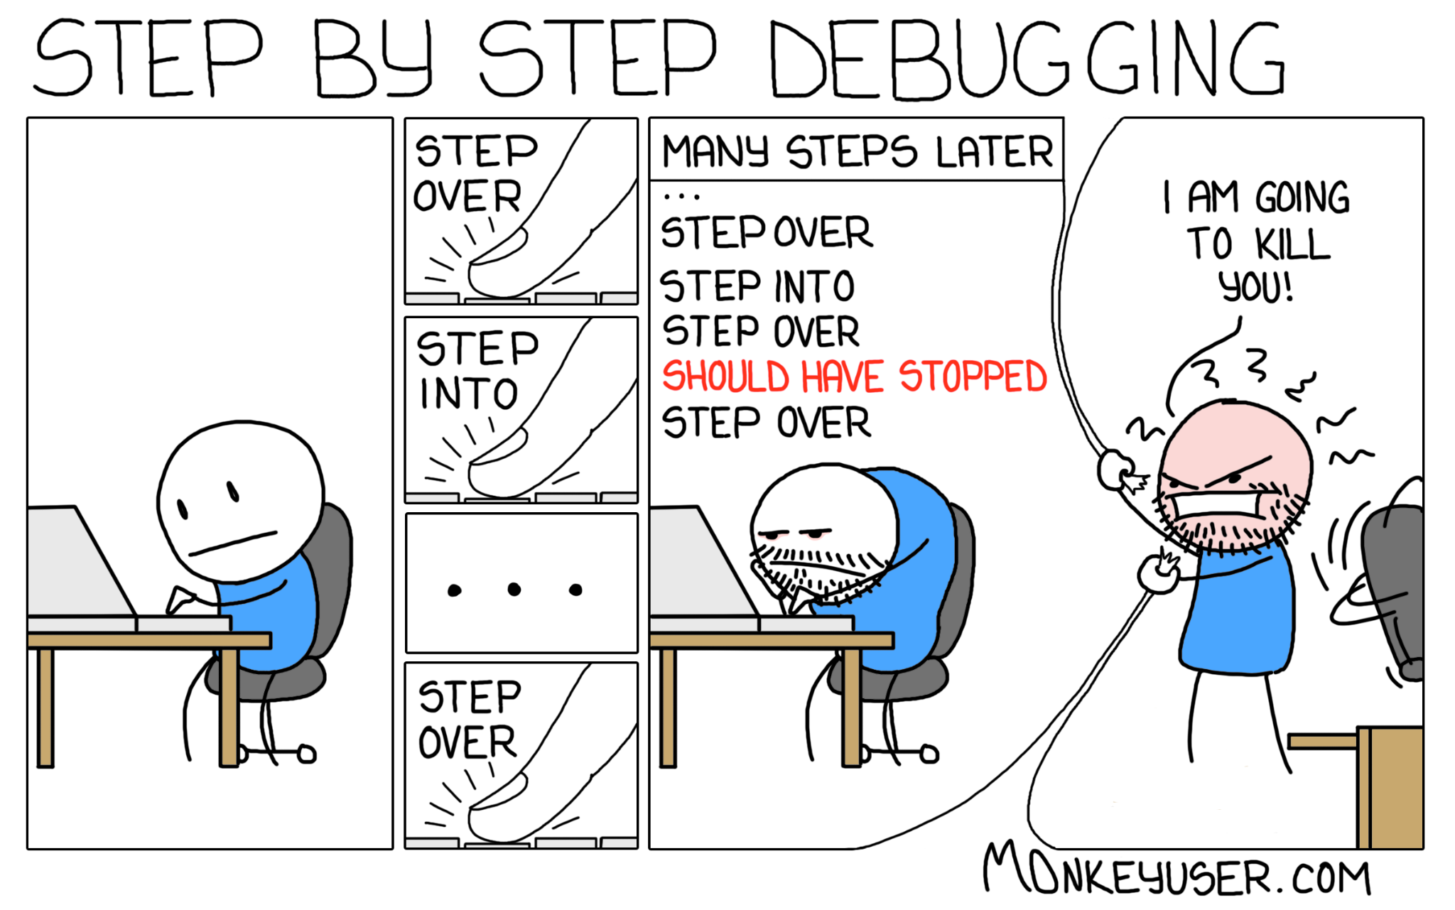
printf’s
vs

Slide 5
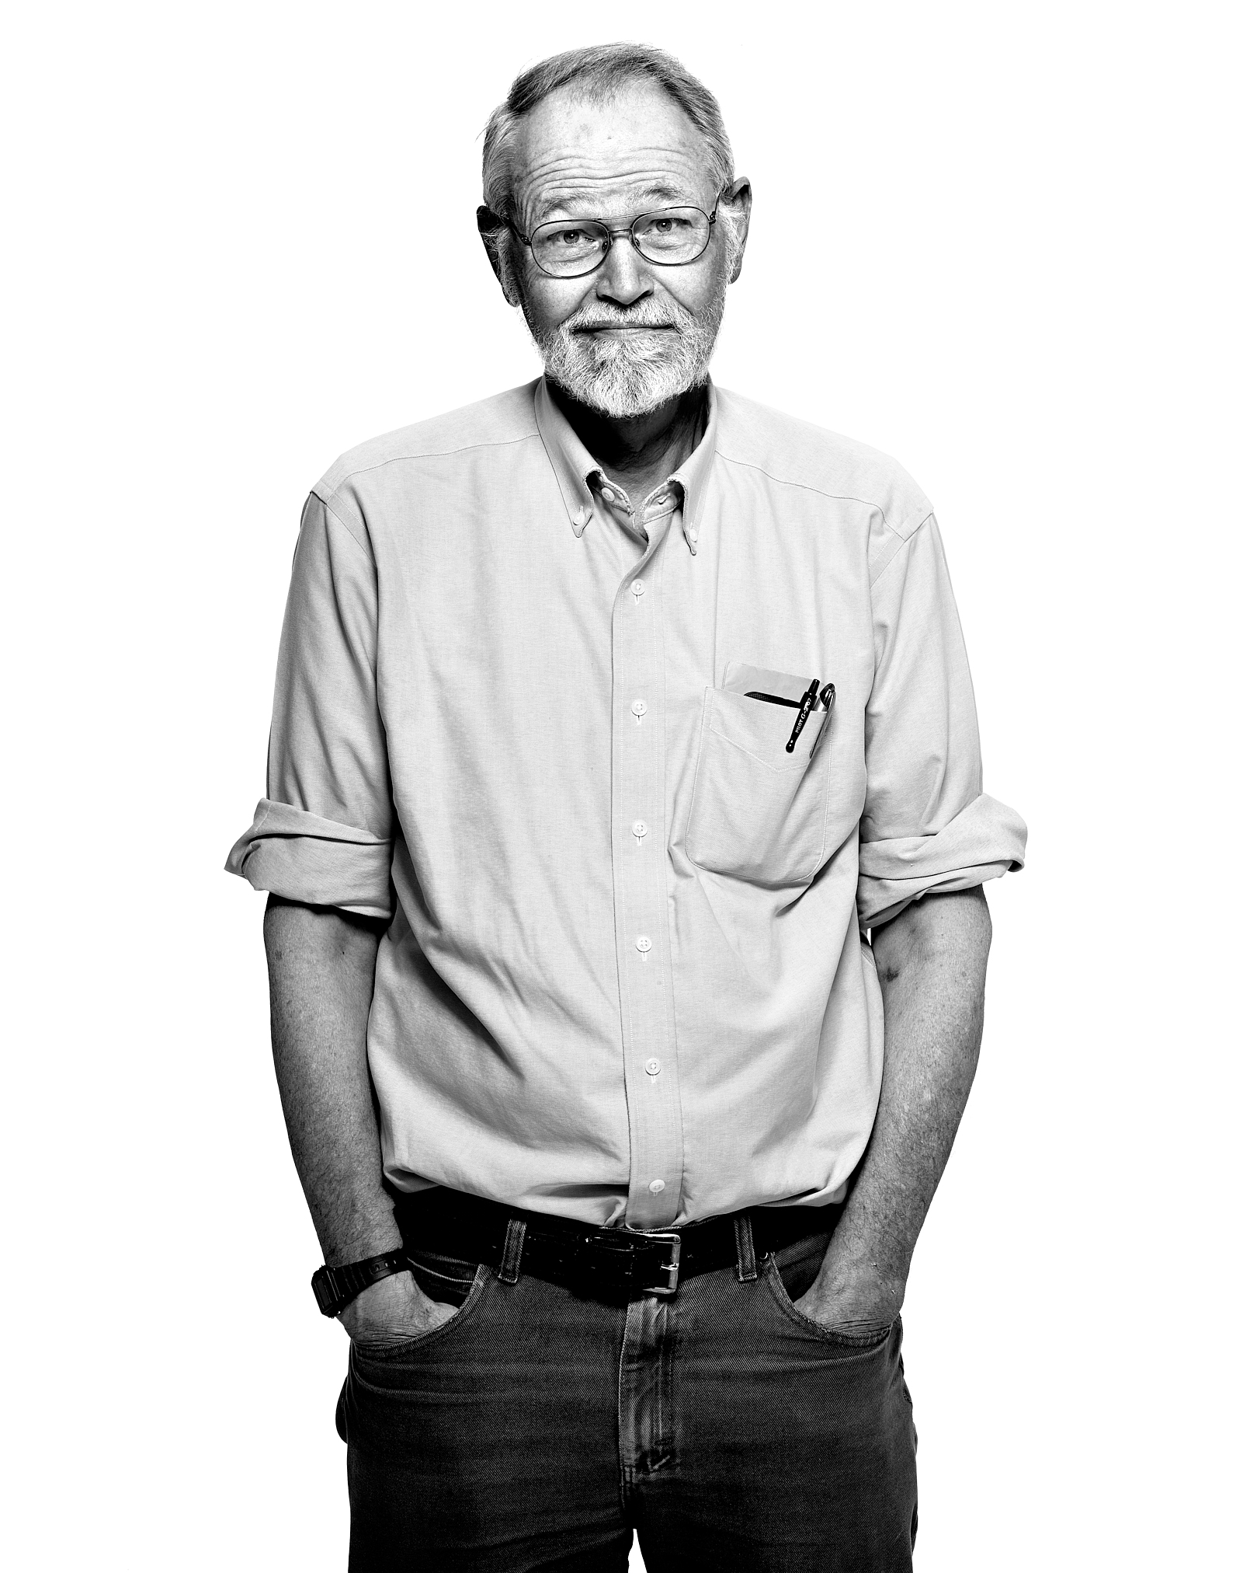
Everyone knows that debugging is twice as hard as writing a program in the first place.
So if you're as clever as you can be when you write it, how will you ever debug it?
Brian Kernighan

Slide 6
How do we debug?
Use dynamic checkers (e.g. valgrind, ASAN)
Use a debugger (e.g. IntelliJ, GDB)
Dynamic logging (e.g. LightRun)
logger.debug() printf()

Slide 8

How did that happen?

Slide 9
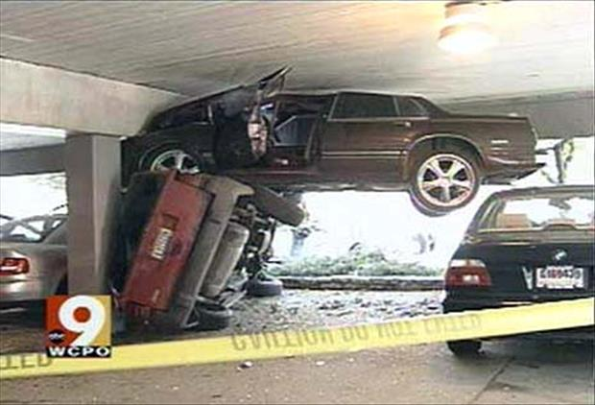

Slide 10
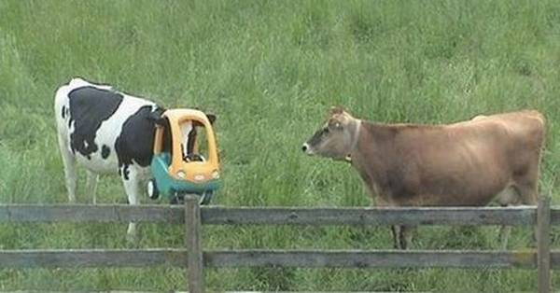

Slide 11
Expectations
Reality

Slide 12


https://undo-university.appsembler.com/event/debugging-multithreaded-c-linux-applications/

Slide 13
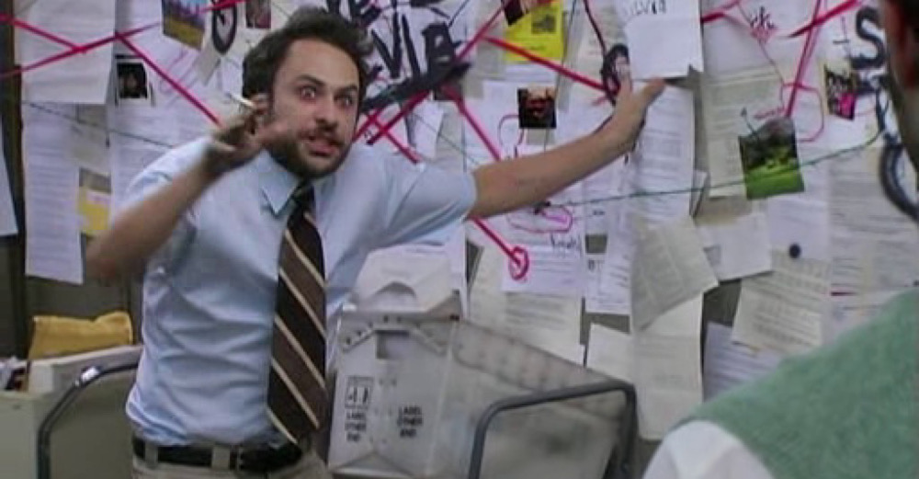

Slide 14

What makes bugs hard to fix?
Non-deterministic
‘Heisenbugs’
Time between bug and failure

Slide 15
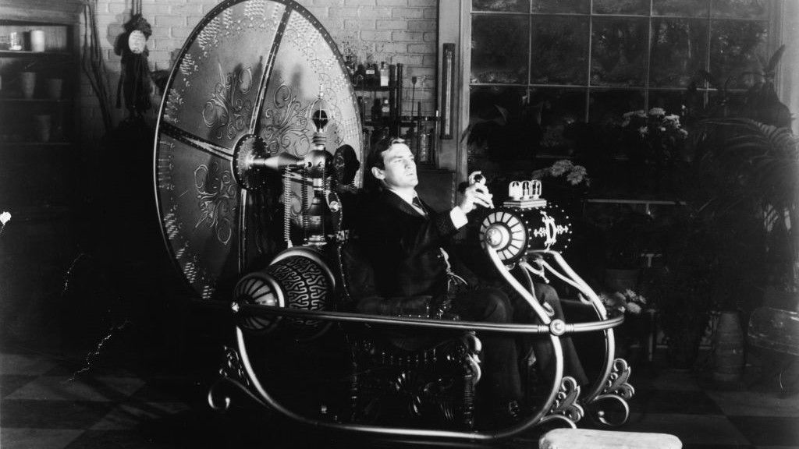

Slide 16
Use cases
Production*
CI/CD
“Inner loop” development

Slide 17
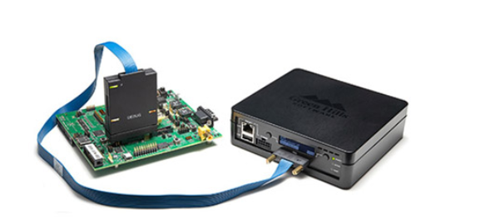
C++ projects and products
Linux
Undo - UDB & LiveRecorder
rr (rr-project.org)
GDB (ish)
Windows
TTD
Embedded
Lauterbach “TRACE32”
Green Hills TimeMachine

Slide 18
Non C++
JavaScript / React replay.io
.Net RevDebug
Visual Studio
Java Undo
Rust, Go Undo / rr

Slide 19
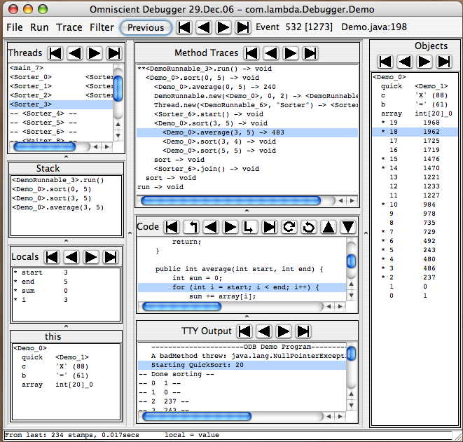

Slide 20
What happened?
What was the previous state?
Two options:
Save it.
Recompute it.
a = a + 1 ✓
a = b ✗

Slide 21
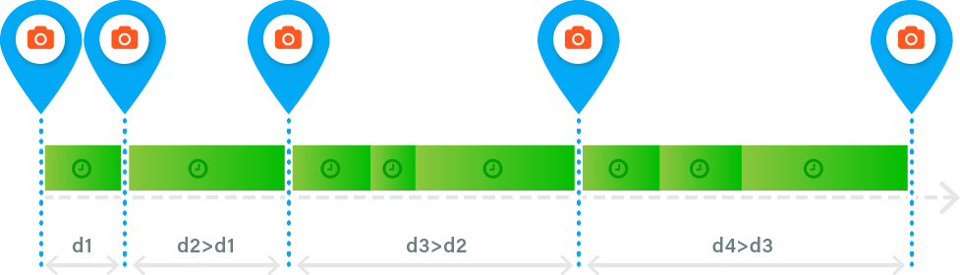
Snapshots
Maintain snapshots through history
Resume from these - run forward as needed
Copy-on-Write for performance & memory efficiency
Adjust spacing to anticipate user’s needs

Slide 22
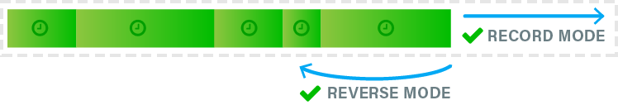
Event log
Event Log captures non-deterministic state
Stored in memory
Efficient, diff-based representation
Recorded during debug (or Live Recording)
Replayed to reconstruct any point in history
Saved to create a recording file for later use

Slide 23
Recording at process/OS ABI boundary
Process 1
Process 2
Process 3
libc
libm
Kernel

Slide 24
Non-determinism
What is unpredictable?
System calls.
Thread switches.
Asynchronous events (signals).
Shared memory accesses.
Some machine instructions.

Slide 25
Design decisions
At what boundary to capture
Binary rewriting instrumentation
All/some/no memory accesses
Separate record/replay phases
Undo | rr | WinDbg | replay.io | ODB
proc | proc | proc | proc | JVM
yes | no | yes | no | no
some | none | all* | none | all
yes/no | yes | yes | yes | yes

Slide 26
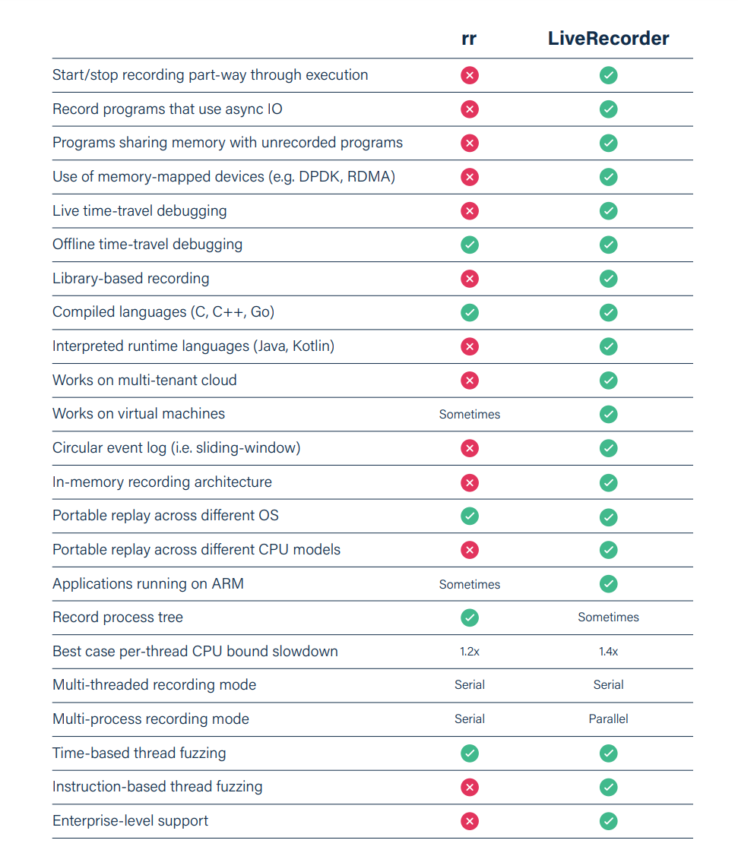
Undo vs rr breakdown
All differences stem from:
JIT vs perf counters
Much more investment
Scale

Slide 27
DEMO TIME!

